Slide 1
What I’ve learned with our edible garden
Katie Decker – Principal Bracken STEAM Academy
Making money to sustain your garden
Alan Diskin - Chief Development Officer

Slide 2
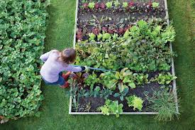
Have a Vision
Get Support
Everybody Helps
Continue to Grow
Notes:
Animated picture buttons grow and turn on path
(Advanced)
To reproduce the curved shape on this slide, do the following:
On the Home tab, in the Slides group, click Layout, and then click Blank.
On the Home tab, in the Drawing group, click Shapes, and then under Basic Shapes click Right Triangle (first row, fourth option from the left).
On the slide, draw a triangle. Under Drawing Tools, on the Format tab, in the Size group, enter 7.5” into the Height box and enter 4.75” into the Width box.
On the Home tab, in the Drawing group, click Arrange, point to Align, and then do the following:
Click Align Middle.
Click Align Left.
On the slide, select the triangle. Under Drawing Tools, on the Format tab, in the Insert Shapes group, click Edit Shape, and then click Edit Points. Right-click the diagonal side of the triangle, and then click Curved Segment. Click the bottom right corner of the triangle and then move the curve adjustment handle to create a consistent curve.
Also on the Format tab, in the Shape Styles group, click Shape Fill, and then under Theme Colors click White, Background 1 (first row, first option from the left).
Also on the Format tab, in the Shape Styles group, click Shape Outline, and then click No Outline.
To reproduce the background effects on this slide, do the following:
On the Design tab, in the Background group, click Background Styles, and then click Format Background. In the Format Background dialog box, click Fill in the left pane, select Gradient fill in the Fill pane, and then do the following:
In the Type list, select Linear.
In the Angle box, enter 225.
Under Gradient stops, click Add gradient stops or Remove gradient stops until two stops appear in the slider.
Also under Gradient stops, customize the gradient stops as follows:
Select the first stop in the slider, and then do the following:
In the Position box, enter 0%.
Click the button next to Color, and then under Theme Colors click White, Background 1 (first row, first option from the left).
In the Transparency box, enter 0%.
Select the first stop in the slider, and then do the following:
In the Position box, enter 100%.
Click the button next to Color, click More Colors, and then in the Colors dialog box, on the Custom tab, enter values for Red: 230, Green: 230, Blue: 230.
To reproduce the picture and text effects on this slide, do the following:
On the Insert tab, in the Images group, click Picture. In the Insert Picture dialog box, select a picture, and then click Insert.
On the slide, select the picture. Under Picture Tools, on the Format tab, in the Size group, click the arrow under Crop, click Crop to Shape, and then under Basic Shapes click Oval (first option from the left).
With the picture still selected, under Picture Tools, on the Format tab, in the Size group, click the Size and Position dialog box launcher. In the Format Picture dialog box, resize or crop the image so that the height is set to 1.2” and the width is set to 1.2”. To crop the picture, click Crop in the left pane, and in the right pane, under Crop position, enter values into the Height, Width, Left, and Top boxes. To resize the picture, click Size in the left pane, and in the right pane, under Size and rotate, enter values into the Height and Width boxes.
Also in the Format Picture dialog box, click 3-D Format in the left pane, and then, in the 3-D Format pane, do the following:
Under Bevel, click the button next to Top and click Circle (first row, first option from the left).
Under Surface, click the button next to Material, and then under Standard click Metal (fourth option from the left).
Click the button next to Lighting, and then under Neutral click Contrasting (second row, second option from the left).
In the Angle box, enter 25°.
Also in the Format Picture dialog box, click Shadow in the left pane. In the Shadow pane, click the button next to Presets, under Outer click Offset Diagonal Bottom Left (first row, third option from the left), and then do the following:
In the Transparency box, enter 77%.
In the Size box, enter 100%.
In the Blur box, enter 10 pt.
In the Angle box, enter 141°.
In the Distance box, enter 10 pt.
On the slide, drag the picture onto the curve, near the top.
On the Insert tab, in the Text group, click Text Box. On the slide, drag to draw the text box.
Enter text in the text box and select it. On the Home tab, in the Font group, do the following:
In the Font list, select Corbel.
In the Font Size box, enter 22.
Click the arrow next to Font Color, and then under Theme Colors click White, Background 1, Darker 50% (sixth row, first option from the left).
On the Home tab, in the Paragraph group, click Align Text Left to align the text left in the text box.
On the slide, drag the text box to the right of the picture.
To reproduce the animation effects on this slide, do the following:
It will help to zoom out in order to view the area off the slide. On the View tab, in the Zoom group, click Zoom. In the Zoom dialog box, select 65%.
On the Animations tab, in the Advanced Animation group, click Add Animation, and then click More Entrance Effects. In the Add Entrance Effect dialog box, under Moderate, click Grow & Turn, and then click OK.
On the Animations tab, in the Timing group, in the Start list, select With Previous.
On the Animations tab, in the Timing group, in the Duration box, enter 1.
On the Animations tab, in the Advanced Animation group, click Add Animation, and then under Motion Paths click Arcs.
On the Animations tab, in the Timing group, in the Start list, select With Previous.
On the Animations tab, in the Timing group, in the Duration box, enter 1.
On the Animations tab, in the Animation group, click Effect Options, and then click Right.
On the Animations tab, in the Animation group, click Effect Options, and then click Reverse Path Direction.
On the slide, select the arc effect path, and then drag the bottom sizing handle below the bottom of the slide. Drag the right side sizing handle to the left until the path curve approximately matches the curve of the modified triangle. Drag the green rotation handle to the left to rotate the arc path to match the curve of the modified triangle. Drag the arc path so that the red arrow is in the center of the picture. You may need to make further adjustments to the length, width, and angle of the arc path to match the curve of the modified triangle.
On the slide, select the text box. On the Animations tab, in the Advanced Animation group, click Add Animation, and then under Entrance click Fade.
On the Animations tab, in the Timing group, in the Start list, select After Previous.
On the Animations tab, in the Timing group, in the Duration box, enter 1.
To reproduce the other animated pictures and text boxes on this slide, do the following:
On the Animations tab, in the Advanced Animation group, click Animation Pane.
On the slide, press and hold CTRL and then select the picture and the text box. On the Home tab, in the Clipboard group, click the arrow next to Copy, and then click Duplicate.
On the slide, drag the duplicate picture and text onto the curve below the first group.
On the slide, select the duplicate picture. Under Picture Tools, on the Format tab, in the Adjust group, click Change Picture. In the Insert Picture dialog box, select a picture, and then click Insert.
Under Picture Tools, on the Format tab, in the Size group, click the Size and Position dialog box launcher. In the Format Picture dialog box, resize or crop the image so that the height is set to 1.2” and the width is set to 1.2”. To crop the picture, click Crop in the left pane, and in the right pane, under Crop position, enter values into the Height, Width, Left, and Top boxes. To resize the picture, click Size in the left pane, and in the right pane, under Size and rotate, enter values into the Height and Width boxes.
In the Animation Pane, click the Arc animation effect for the new picture. Drag the green rotation handle to the right to rotate the arc path to match the curve of the modified triangle. Drag the arc path so that the red arrow is in the center of the picture.
Click in the duplicate text box and edit the text.
Repeat steps 2-7 two more times to reproduce the third and fourth pictures and text boxes with animation effects.

Slide 3
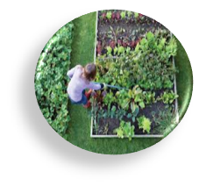
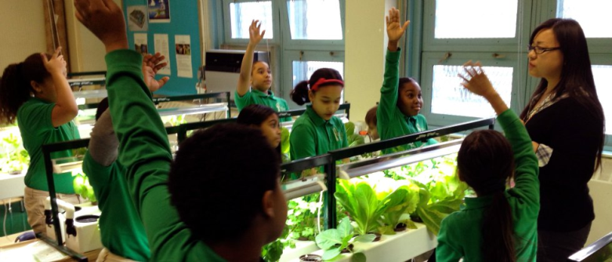
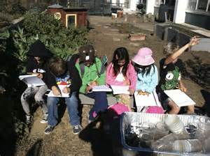
You have to start with a vision
Curriculum through Hands On Learning
Nutrition and Healthy Food
Engineering
The Arts
School Climate
Community Engagement

Slide 5
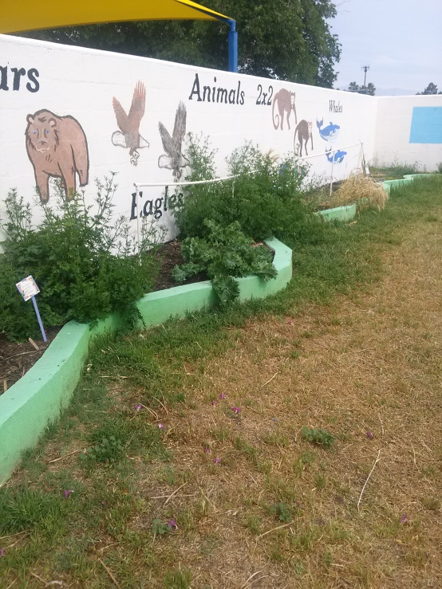
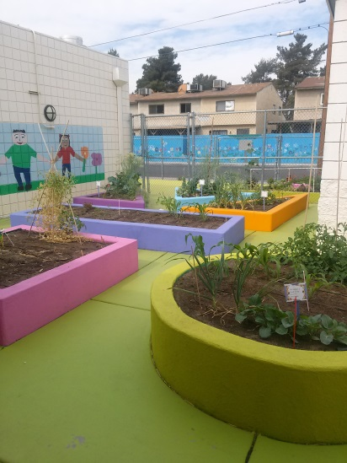
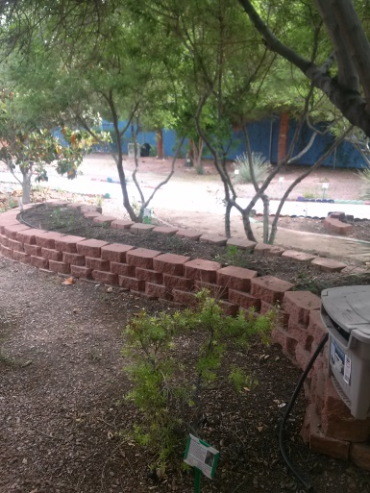
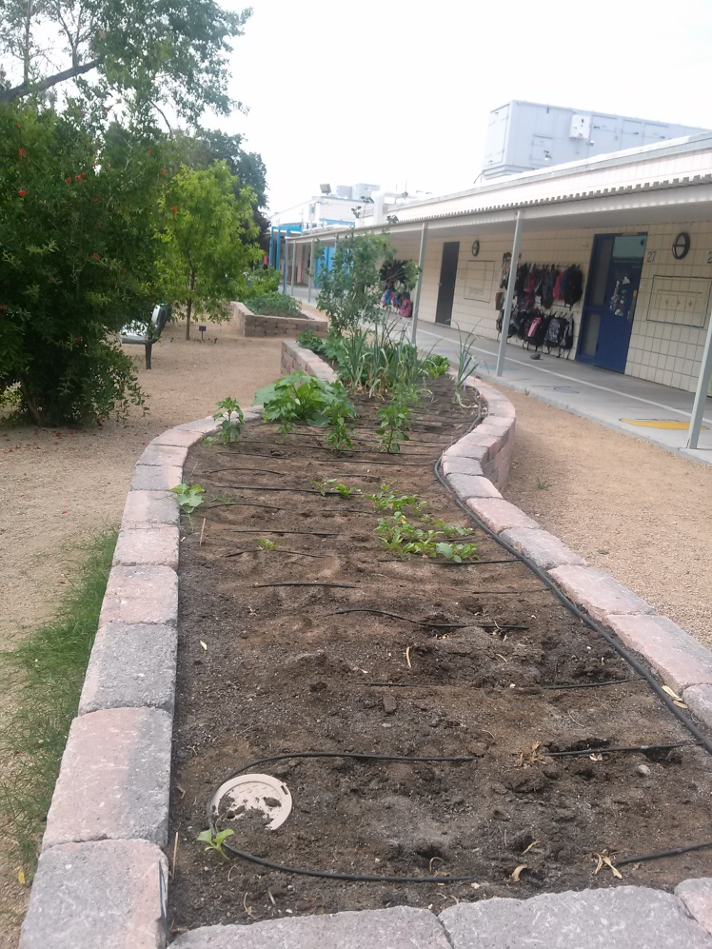
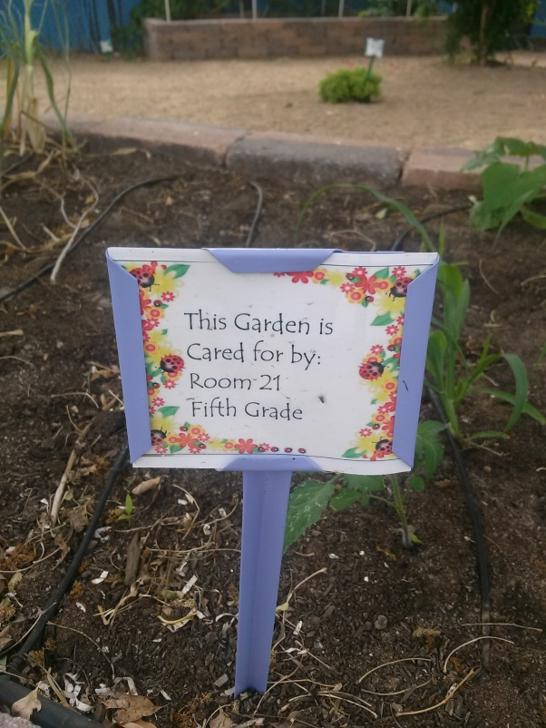
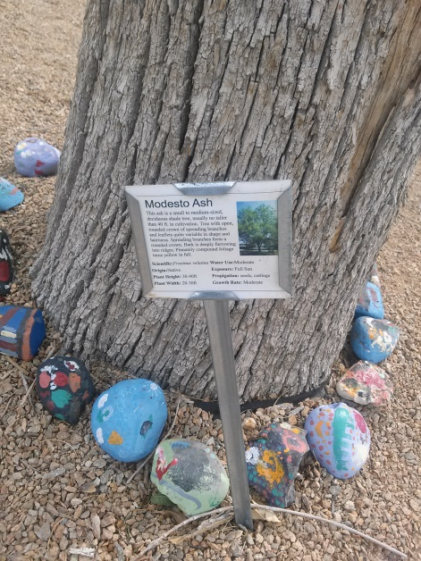
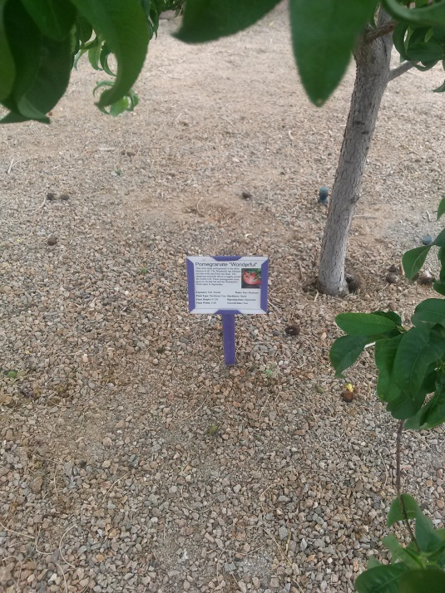
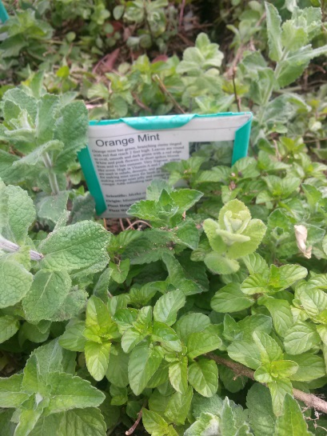

Slide 6
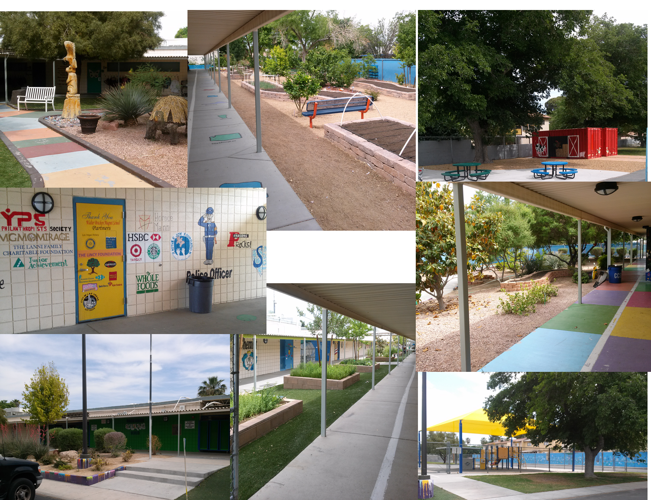

Slide 7
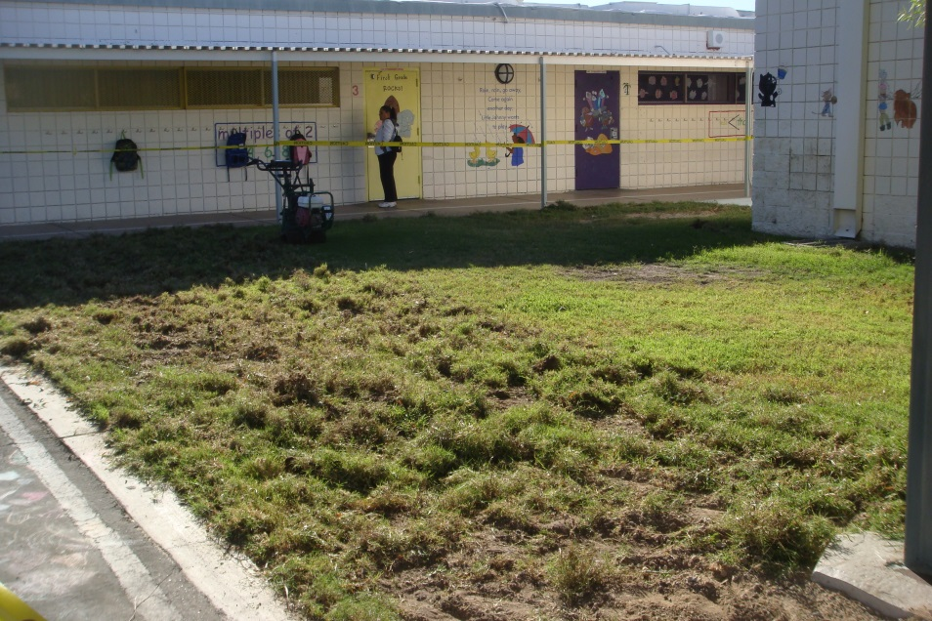
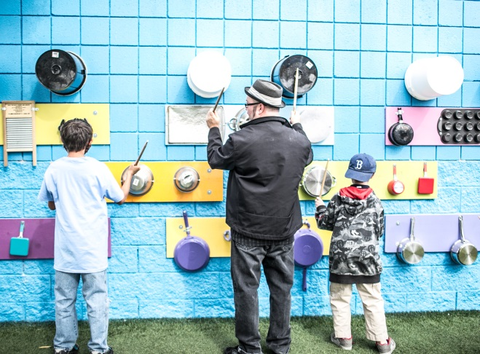
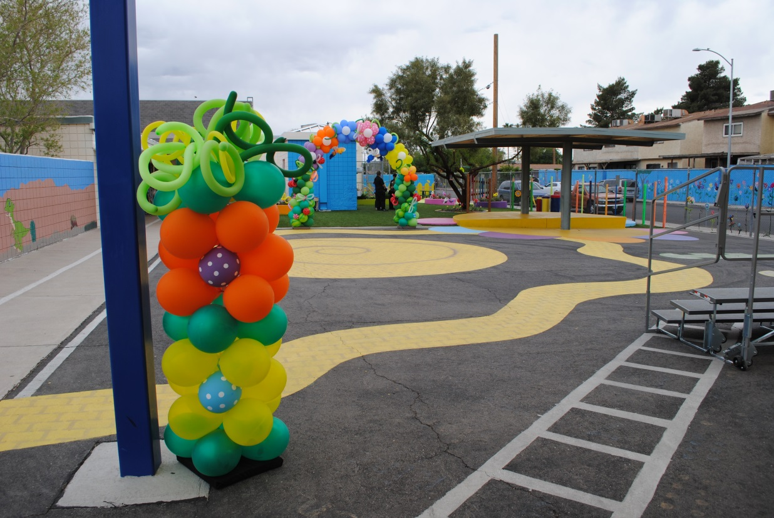
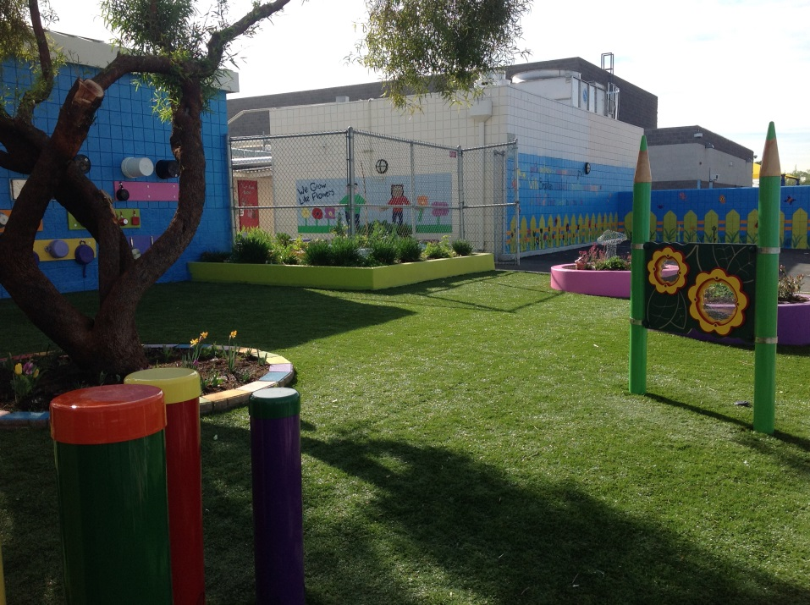

Slide 8
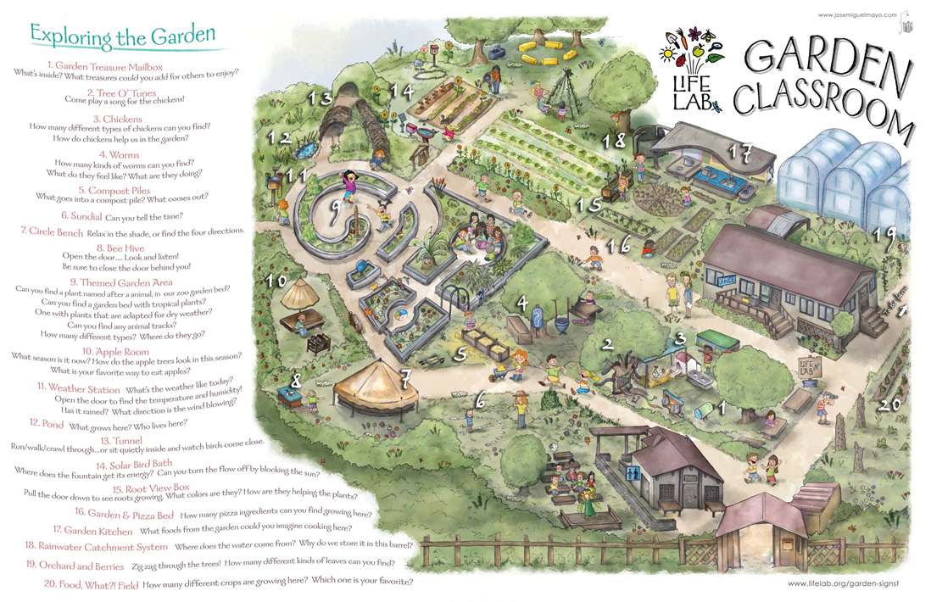

Slide 9
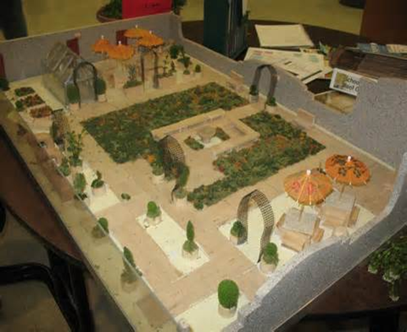
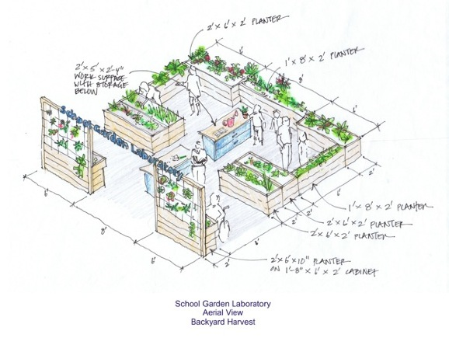
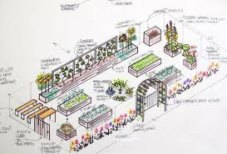

Slide 10
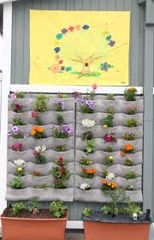
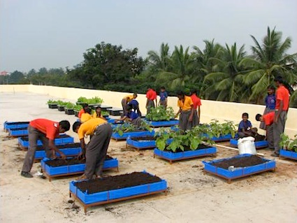
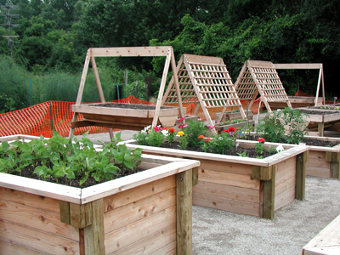
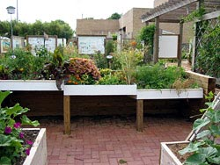
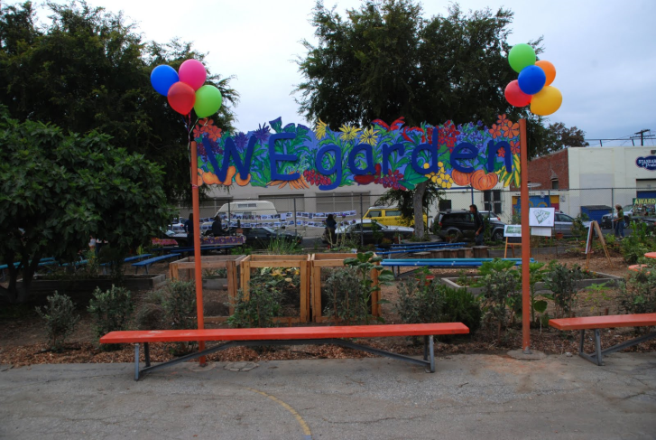
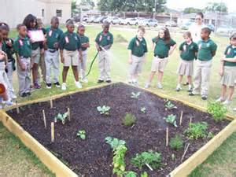
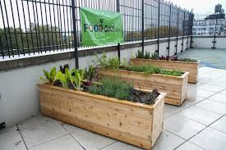

Slide 11
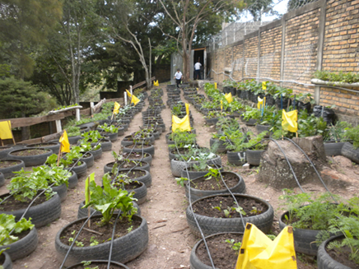
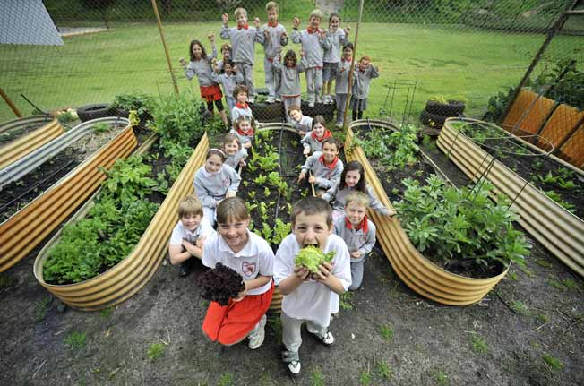
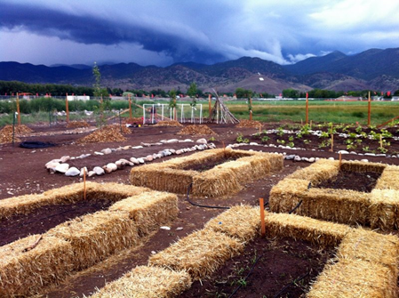
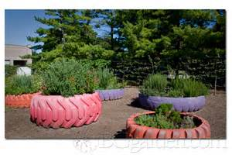
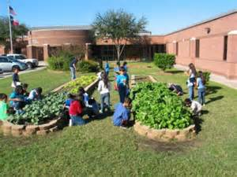
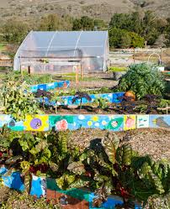
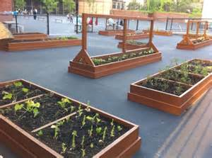
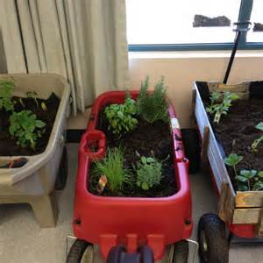
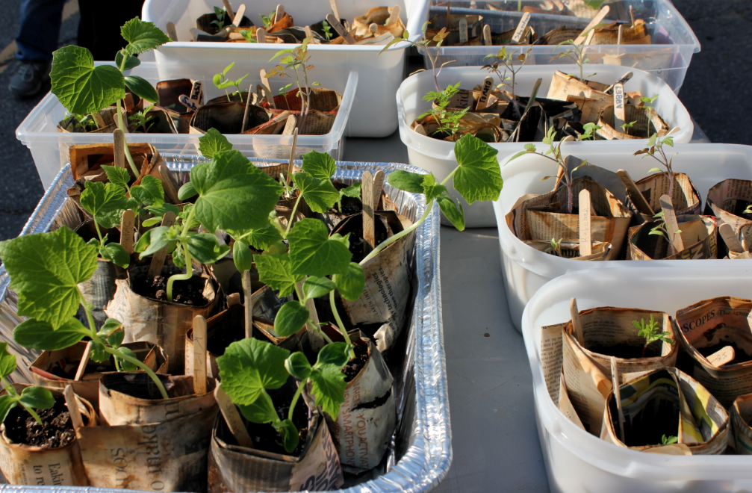
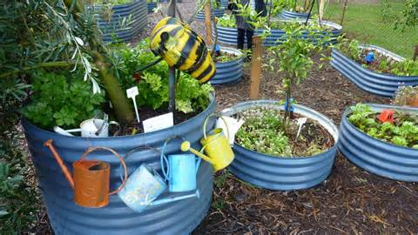

Slide 12
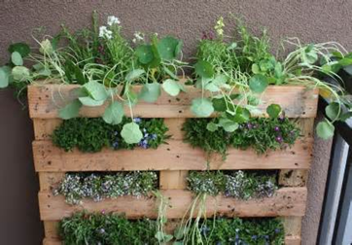
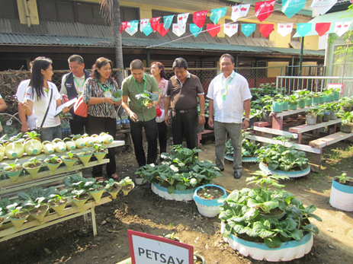
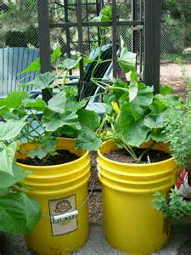
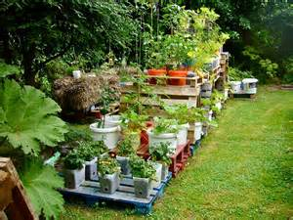
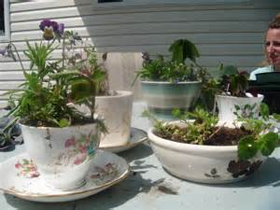

Slide 13
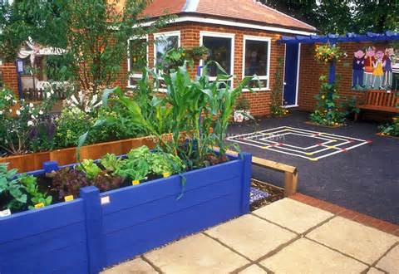
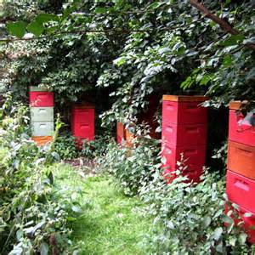
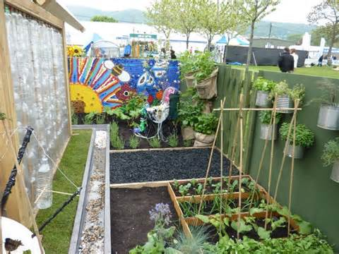
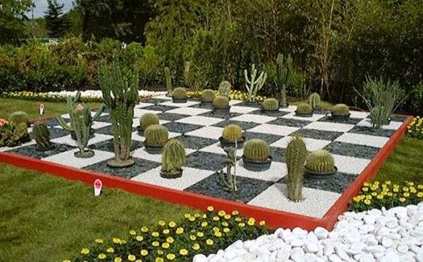
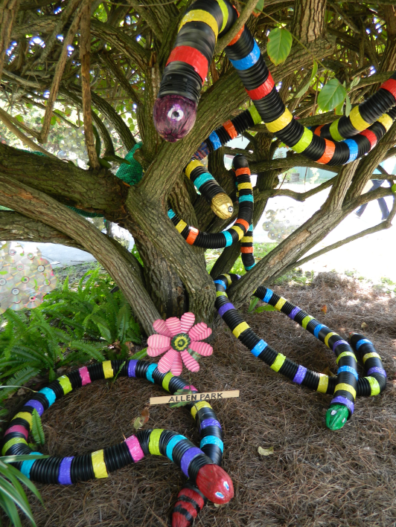
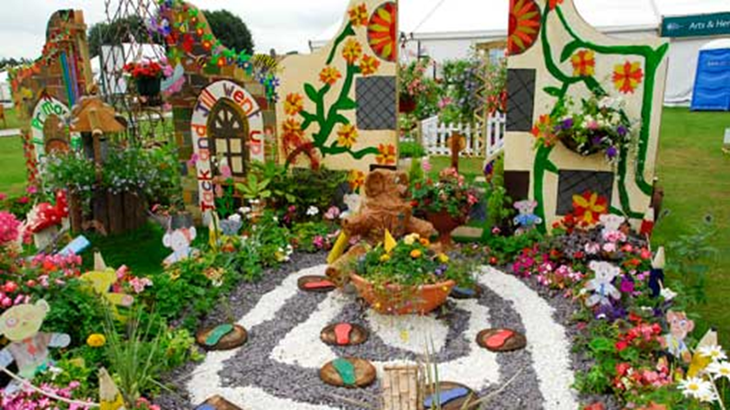
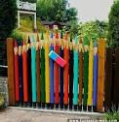

Slide 15
Raising Money for your Garden

Slide 17
Resources
http://edibleschoolyard.org/node/1143
• Garden or harvest festivals, where attendees are encouraged to donate to the
garden in exchange for admission, and are able to donate more in exchange for
goods like produce or art, or activities like music, face painting, or games
• Farm stands, where gardens offer produce to neighbors in exchange for a
suggested donation
• Community concerts, or theater or dance performances, where musicians, actors, or
dancers in your garden or in your community volunteer their time, and the public
makes a donation in exchange for admission
• Community art shows, where gardeners or local artists provide the art, and the
proceeds go to the garden
• Garden-wide yard sales, where all proceeds go to the garden

Slide 18
Plan Events
Percent days, where a business donates a percentage of their daily sales to your garden. 5 or 10% is typical.
Special goods or menu items whose sales benefit your garden
Special events, where a restaurant or bar hosts an event and the proceeds benefit your garden

Slide 20
Plain ol’ garden sponsorships, where a business donates to the garden in exchange for recognition on signage, newsletters, social media, or in other ways
http://www.woollyschoolgarden.org/support.html

Slide 21
Advertise, Advertise, Advertise
Adopt-a-Garden Program
Approach community businesses and ask them to sponsor the garden (or a few rows) in exchange for advertising at the garden site.
Facebook Make a Facebook page for your garden, and include a link that will let people donate to the garden on-line. This will help to raise awareness for your projects and provide a source of revenue.
Razoo/kickstarter On these websites (www.razoo.com / www.kickstarter.com) community groups post their projects and fundraising goals. People can read the descriptions and donate on-line.
Apply for Grants We found a bunch of grant opportunities that may be applicable to your garden projects.

Slide 22
Everybody Helps!
VOLUNTEERING
Volunteers keep our gardens – and the children who learn in them – growing! Please consider sharing your time and talents with REAL School Gardens. We currently have volunteer opportunities in our North Texas Region.
If you are a corporation or group looking for a team building activity, we offer a fun and turn-key community building and volunteering day, where managers and employees working side by side with teachers, parents and students to bring a garden to life.

Slide 24
Slow Food Maui is sponsoring one of the Work and Learn Days at the Kihei Elementary School Garden on November 12, and we need volunteers! Work starts at 8:00 a.m. and they usually finish up about 11:00 a.m., but people don’t need to be there the whole time.
Here is what is expected from sponsors:
•Bring local, healthy snacks for about 20-25 people. (Fresh fruit, baked goodies, etc.) Nothing too fancy as they are in the garden! There are no kitchen facilities available.
•They’ll supply water, but if we want to bring some other drinks, that’s great. They’ll supply cups, napkins, plates and silverware (as needed.) Finger food usually works the best!
•They love it when their sponsors get dirty with them in the garden. Please bring hat and gloves, and wear close-toed shoes.
•Be prepared to tell people about Slow Food Maui and how they can get involved.
•They usually have a mix of community volunteers, teachers, parents and kids.
We need your help! Please contact us if you’re able to lend a hand for this great cause!

Slide 25
Continue to Grow
http://www.kidsgardening.org/classroom-projects
http://sproutrobot.com/
http://letsgrowveggies.com/

