Slide 1

Charming Students into a series
Presenters:
Kathleen Decker- Principal
Christine Herbert- Magnet Theme Coordinator

Slide 2
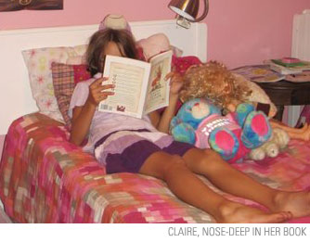
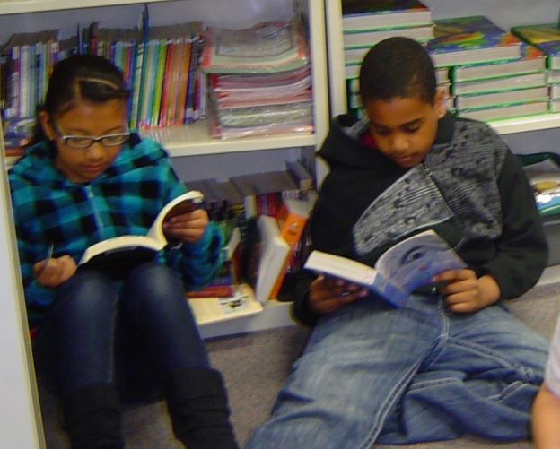

Are your kids seriously reading?
Are they really finishing books?
Do they read on
their own?
Or do they look like this?

Slide 3
The Problem:
Students read a lot of information today in short bursts.
They change channels and multi-task.
To develop good reading comprehension we want them to sustain interest and finish the novels that they start reading.
As soon as they are done we want them to have the desire to read another.
Some classroom teachers are not familiar with current book series choices.
Most teachers have a wide range of levels in their rooms.

Slide 4
Our Solution
Have all students read complete series of books.
Change one of our Explorations classes to be a book series class for 1st grade.
Have individual goals and rewards.
Establish grade level benchmarks for success.
Have all staff members participate for a common mission throughout the school.

Slide 5
Monitor Data at the same point
AR Results |  | 8/23/2009—11/16/2009 |  |  | 8/23/2010—11/16/2010 |  |  | 8/23/2011-11/16/2011 |  |  | 8/23/2012 - 11/16/2012 |  |  | Difference in Points
Last Year Compared to the Current Year |  | # | % At Risk | Total | # | % At Risk | Total | # | % At Risk | Total | # | % At Risk | Total
First Grade | Ames | 15 | N/A | N/A | 15 | 66.7 | 23.8 | 23 | 17.4 | 233.6 | 22 | 9.1 | 616.4 | 382.8
 | King*new | 18 | N/A | N/A | 18 | 66.7 | 61.8 | 23 | 26.1 | 253.9 | 22 | 4.5 | 829.3 | 575.4
 | Petrie | 16 | N/A | N/A | 16 | 56.3 | 83 | 21 | 28.6 | 264.2 | 22 | 27.3 | 652.2 | 388
 | Pierson | 19 | N/A | N/A | 19 | 57.9 | 66.2 | 22 | 31.8 | 204.7 | 23 | 27.3 | 877.5 | 672.8
 | Williams | 18 | N/A | N/A | 18 | 50 | 33.8 | 22 | 18.2 | 187.1 | 22 | 0 | 522 | 334.9
Grade Level |  |  |  |  | 86 | 268.6 | 268.6 | 114 | 25.4 | 1156.8 | 111 | 27 | 3497.4 | 2340.6
Second | Corry | 18 | 88.9 | 9.7 | 18 | 72.2 | 24.5 | 20 | 65 | 411.1 | 22 | 31.8 | 509.4 | 98.3
Grade | Deguevara | 17 | 64.7 | 25.7 | 17 | 23.5 | 194.4 | 20 | 15 | 414.8 | 22 | 0 | 919.4 | 504.6
 | Hermansen | 18 | 77.8 | 16.3 | 18 | 16.7 | 522.1 | 18 | 16.7 | 626 | 22 | 22.7 | 673.7 | 47.7
 | Toolanen | 15 | 73.3 | 21.9 | 15 | 33.3 | 111.2 | 19 | 5.3 | 318 | 22 | 0 | 829.6 | 511.6
 | Swanson* | 18 | 72.2 | 8 | 18 | 72.2 | 84.5 | 20 | 35 | 415.9 | 22 | 9.1 | 439.7 | 23.8
Grade Level |  |  | 75.6 | 81.6 | 86 | 44.2 | 936.7 | 98 | 27.6 | 2201.5 | 110 | 20 | 3371.8 | 1170.3
Third Grade | Barrow | 19 | 63.2 | 244 | 19 | 36.8 | 551.3 | 22 | 27.3 | 530.9 | 22 | 31.8 | 663.8 | 132.9
 | Bennett | 20 | 60 | 129.8 | 20 | 25 | 296.9 | 22 | 27.3 | 567.8 | 22 | 22.7 | 705.8 | 138
 | DeMott | 19 | 75 | 113.6 | 20 | 45 | 243.3 | 22 | 31.8 | 314.1 | 22 | 27.3 | 725 | 410.9
 | Friedrich* | 20 | 63.2 | 129.6 | 19 | 63.2 | 280.1 | 22 | 27.3 | 557 | 22 | 45.5 | 354.2 | -202.8
Grade Level |  |  | 65.4 | 617 | 78 | 42.3 | 1371.6 | 88 | 28.6 | 2013.7 | 88 | 30 | 2448.8 | 435.1
Fourth Grade | Robledo | 27 | 63 | 247.3 | 28 | 59.3 | 285 | 29 | 44.8 | 842.8 | 28 | 25 | 825.4 | -17.4
 | Bourgault* | 29 | 48.1 | 456.8 | 28 | 33.3 | 584.9 | 28 | 35.7 | 824.4 | 28 | 25 | 762.3 | -62.1
 | Zblewski | 27 | 58.6 | 261.4 | 28 | 44.8 | 747.3 | 29 | 34.5 | 749.2 | 28 | 41.4 | 849.9 | 100.7
Grade Level |  | 83 | 56.6 | 965.5 | 84 | 45.8 | 1617.2 | 86 | 38.7 | 2594.4 | 87 | 40 | 2437.6 | -156.8
Fifth Grade | Nelson* | 28 | 64.3 | 611.9 | 28 | 28.6 | 1003.6 | 28 | 42.9 | 1010.6 | 28 | 35.7 | 1060.2 | 49.6
 | Harris | 28 | 85.7 | 244.5 | 28 | 71.4 | 204.5 | 28 | 50 | 682.3 | 28 | 46.4 | 865.7 | 183.4
 | Wheatfill | 28 | 75 | 183.4 | 28 | 60.7 | 416.3 | 28 | 39.3 | 1250.4 | 28 | 35.7 | 1349.4 | 99
Grade Level |  | 84 | 75 | 1039.8 | 84 | 53.6 | 1624.4 | 84 | 45.3 | 2975.9 | 84 | 47.6 | 3275.3 | 299.4
School Total |  | 417 | 74.8 | 2703.9 | 417 | 49.2 | 5818.5 | 482 | 32.6 | 10942.3 | 481 | 34.1 | 15030.9 | 4088.6

Slide 6
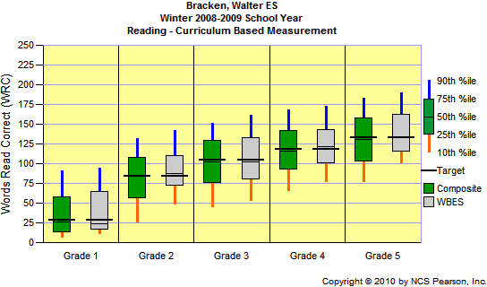
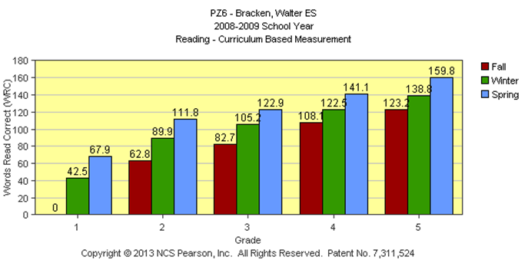
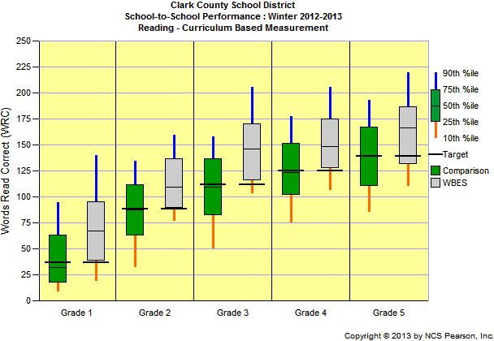
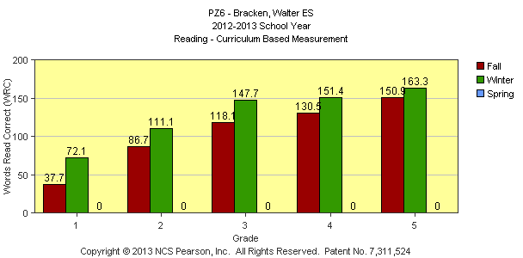
Results!!
Better Reading
Fluency In ALL Grades!

Slide 7
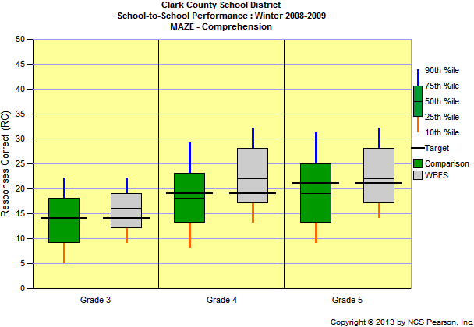
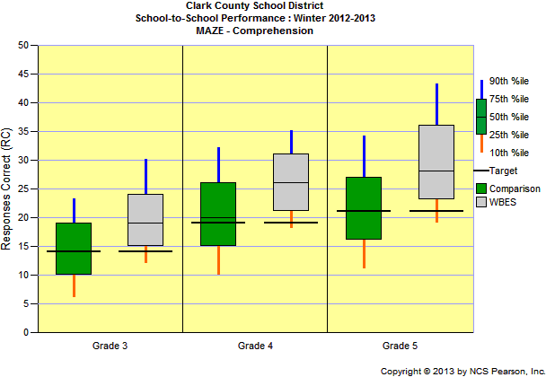
Comprehension Improves!

Slide 8
Results!
The Percent at Risk is determined by our benchmark of
Scoring below 85% on the quiz that they take.

Slide 9
State Exam Results

Slide 10
What we had to do first:
Have everyone just start with one series.
Purchase 16 books to get everyone started.
Teach a mini book club class to get them started.
Get everyone involved including parents.
Stick to the series idea – tricky at first but it will pay off!
Be flexible – you are changing bad habits for older kids. The younger grades are the easiest to start!

Slide 11
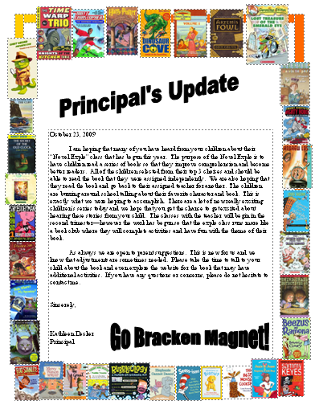
October 23, 2009
I am hoping that many of you have heard from your children about their “Novel Explo” class that has begun this year. The purpose of the Novel Explo is to have children read a series of books so that they improve comprehension and become better readers. All of the children selected from their top 3 choices and should be able to read the book that they were assigned independently. We are also hoping that they read the book and go back to their assigned teacher for another. The children are buzzing around school talking about their favorite character and book. This is exactly what we were hoping to accomplish. There are a lot of new really exciting children’s series today and we hope that you get the chance to get excited about hearing these stories from your child. The classes with the teacher will begin in the second trimester—however the work has begun so that the explo class runs more like a book club where they will complete activities and have fun with the theme of their book.
As always we are open to parent suggestions. This is new for us and we know that adjustments are sometimes needed. Please take the time to talk to your child about the book and even explore the website for the book that may have additional activities. If you have any questions or concerns, please do not hesitate to contact me.
Sincerely,
Kathleen Decker
Principal

Slide 12
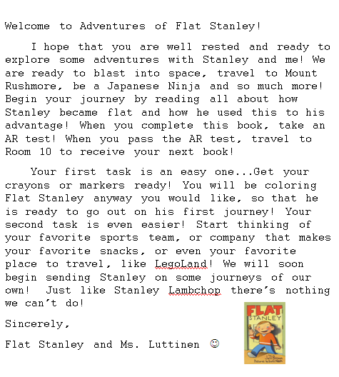

Slide 13
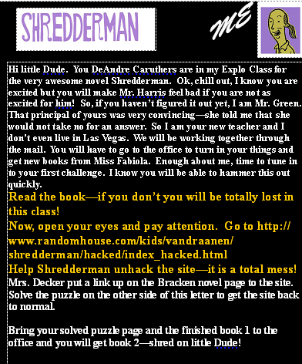
Give them the 1st book in a creative way!

Slide 14
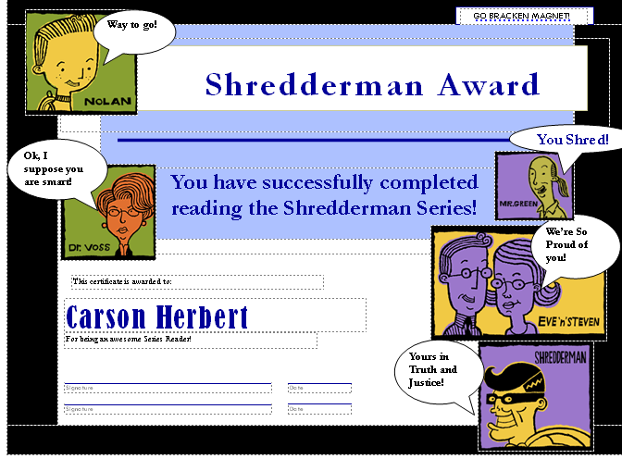

Slide 15
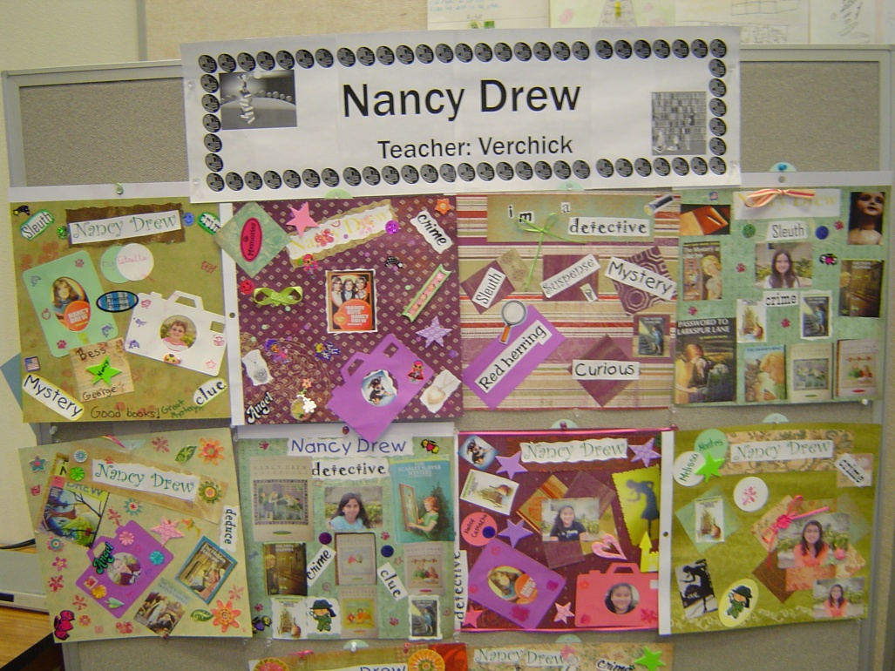
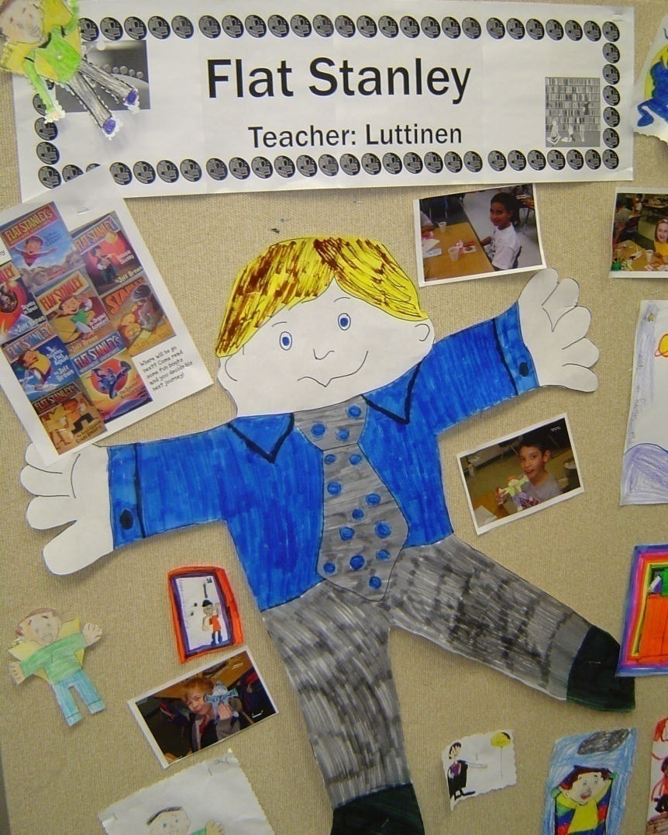
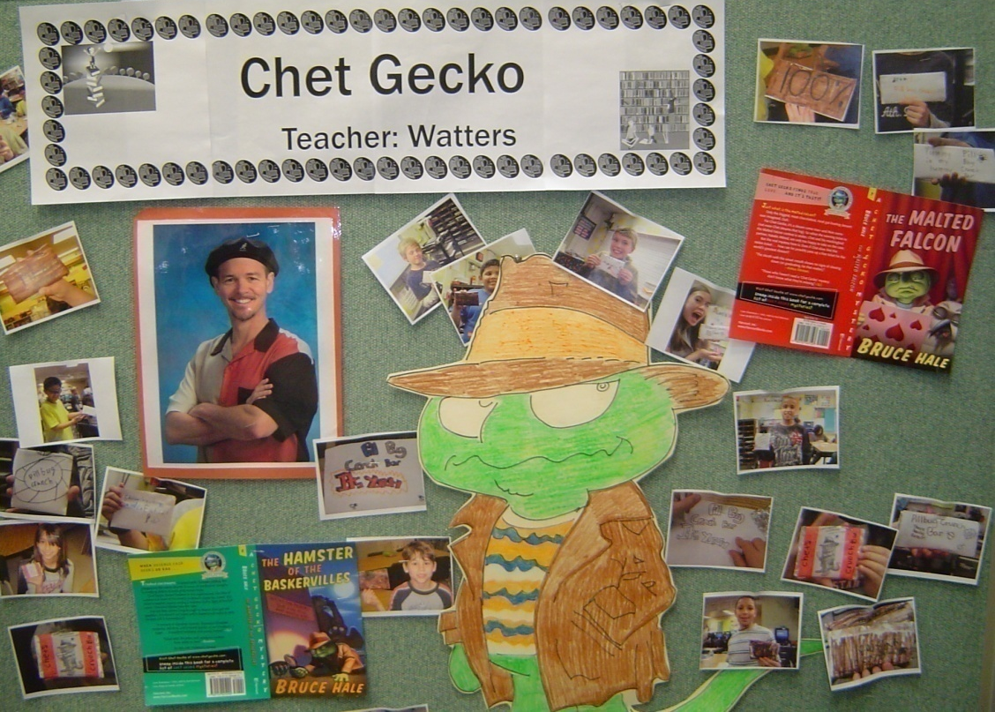

Slide 16
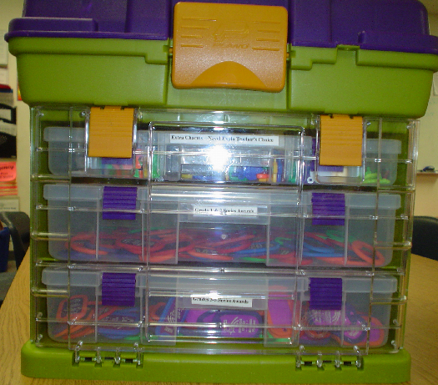
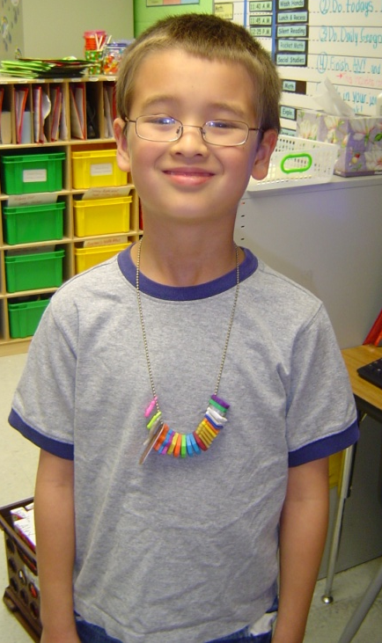
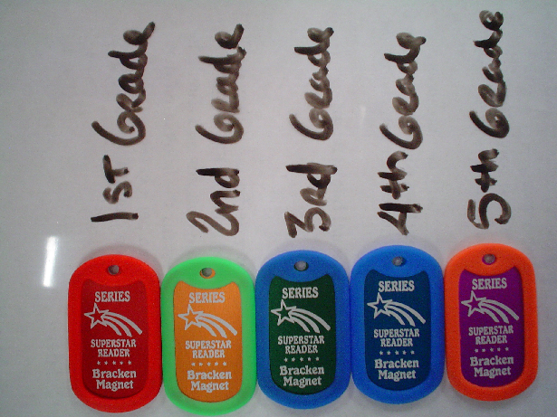
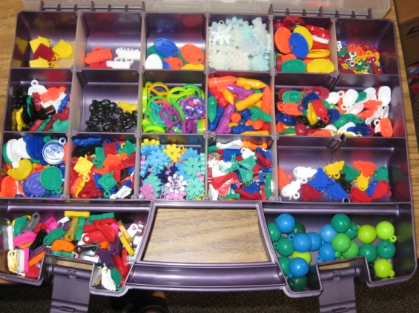
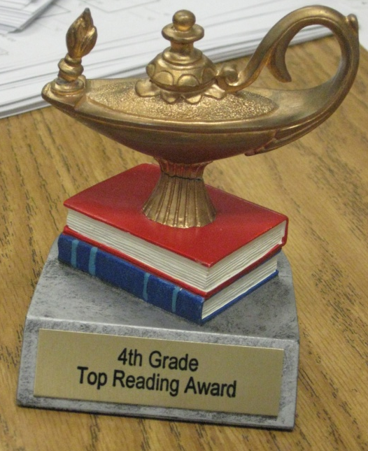
Have a reward system set up for consistency
1st Grade
2nd Grade
3rd Grade
4th Grade
5th Grade
http://www.fitnessfinders.net/

Slide 17
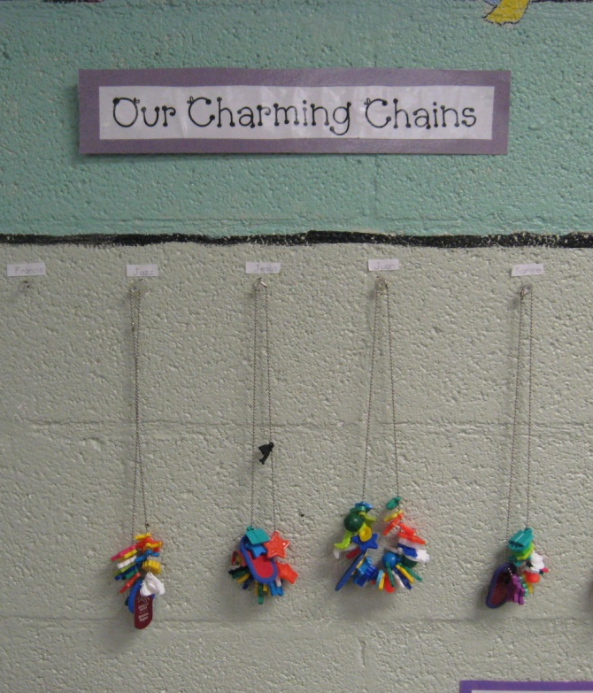
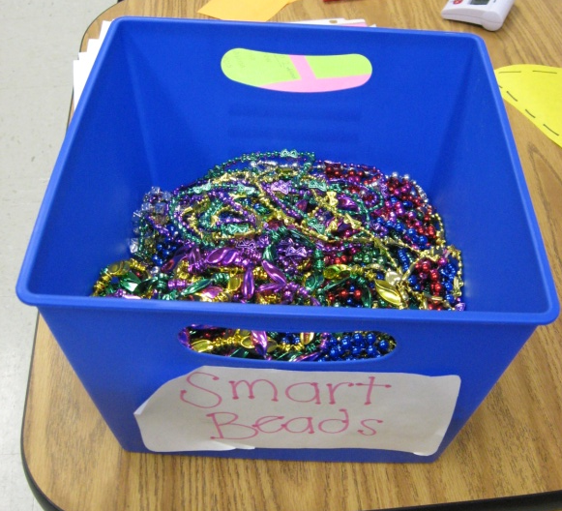
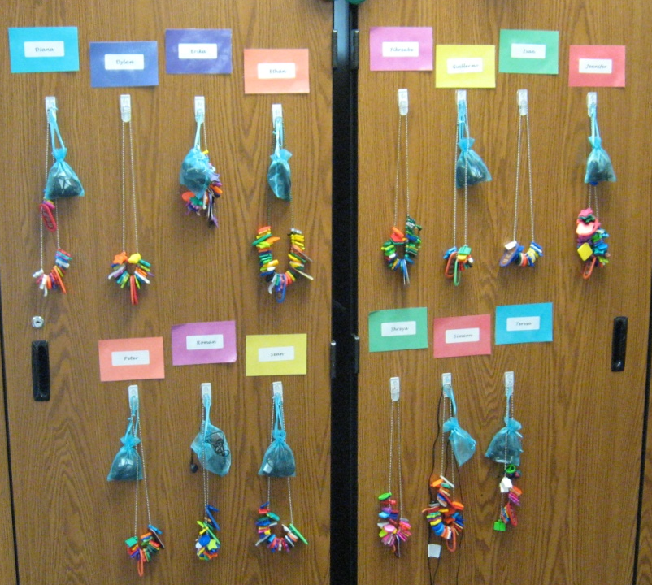
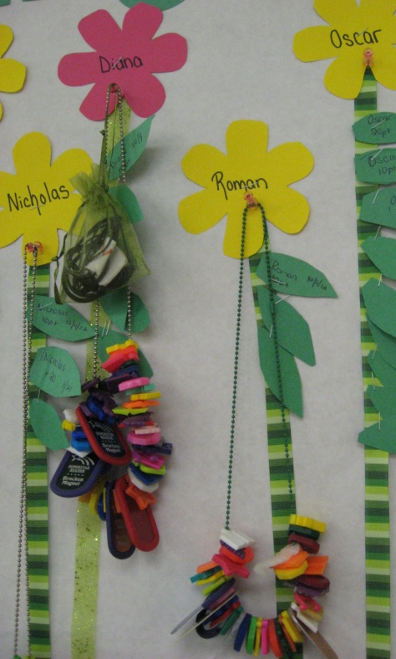
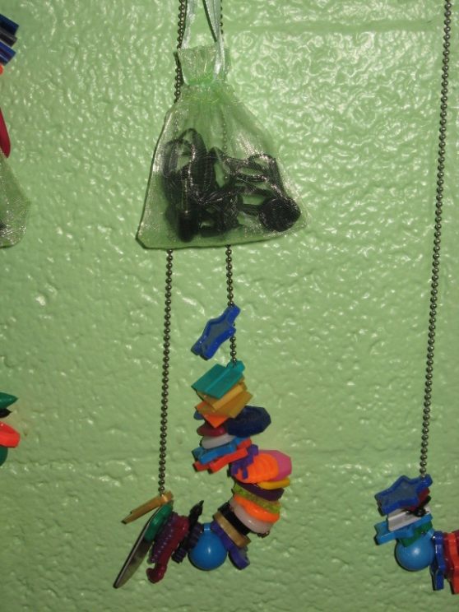
Rewards

Slide 18
Now what we do
Have staff members select the series that they are able to promote.
Have the teachers buy the books and store them in the classroom. Currently we purchase 6 of each title.
Prepare bookmarks for keeping track of the series.
Prepare facebookmarks for the staff to track who is reading their series.
Prepare the Website for kids to become familiar with the choices.

Slide 19


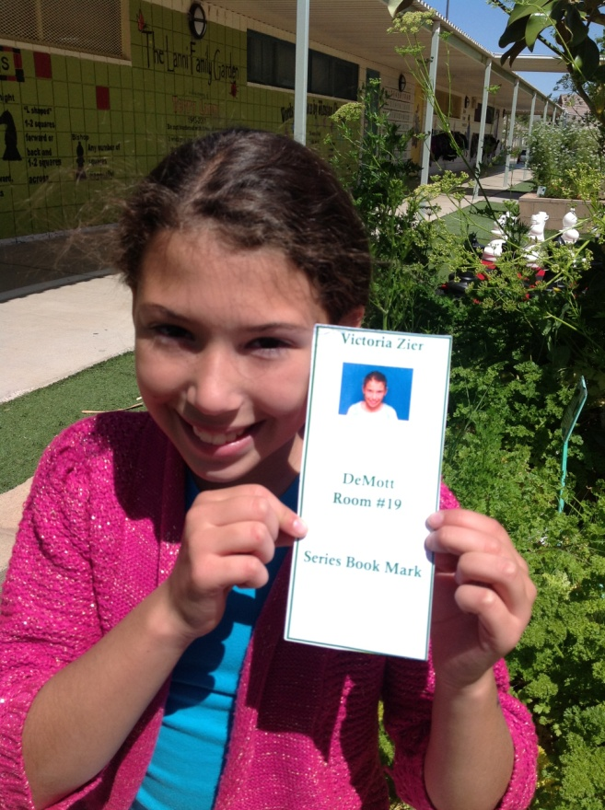
Face
Bookmark

Slide 20
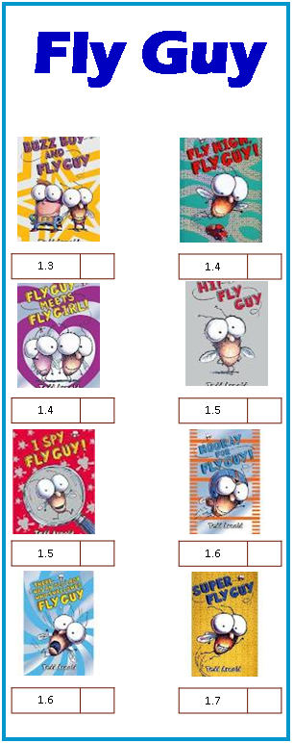
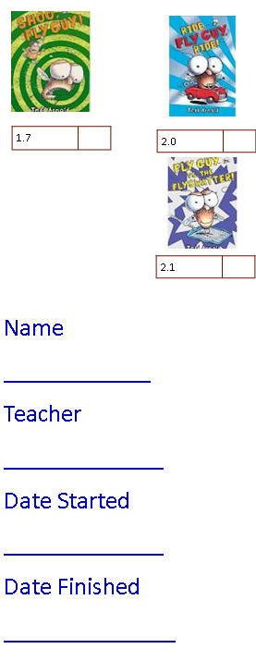
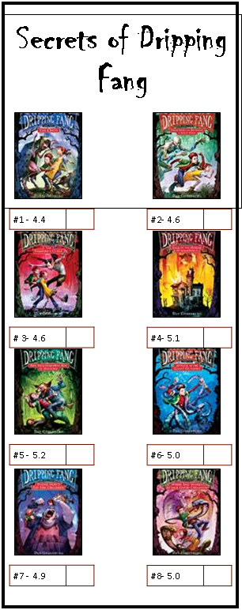
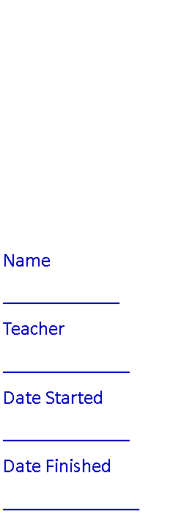
Series Bookmark

Slide 21
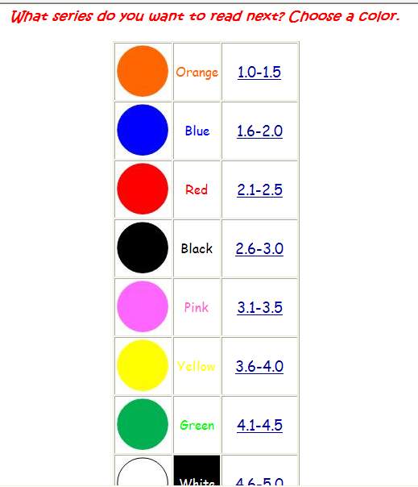
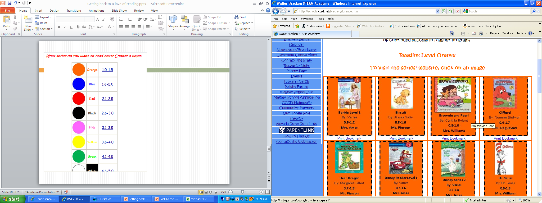
Website

Slide 22
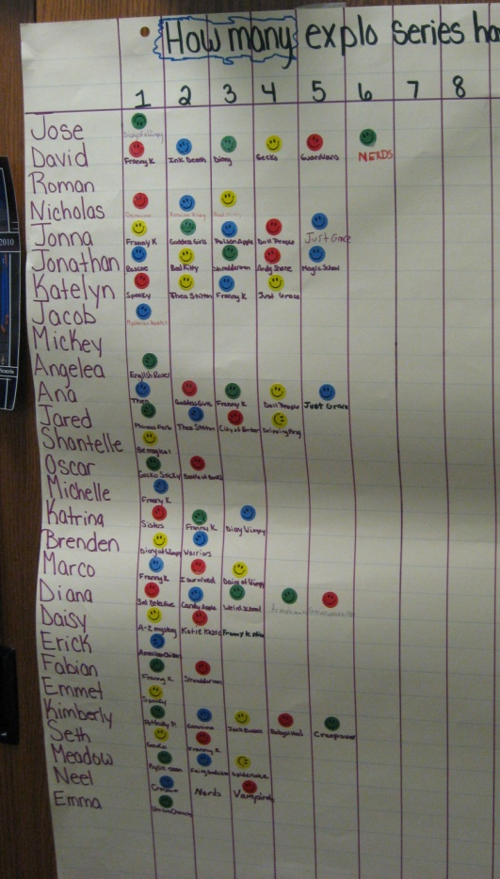
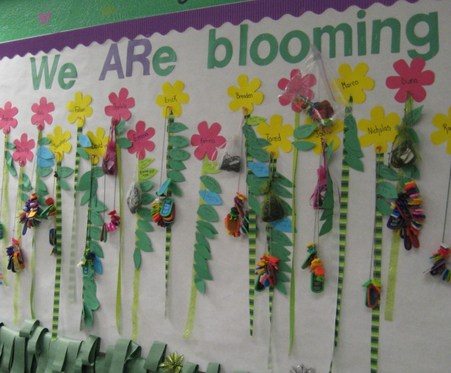
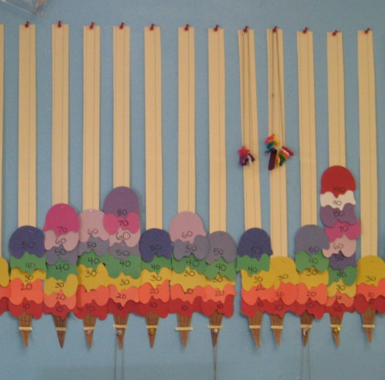
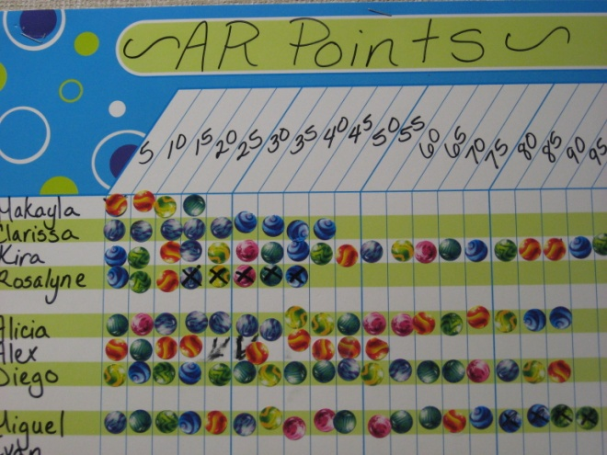
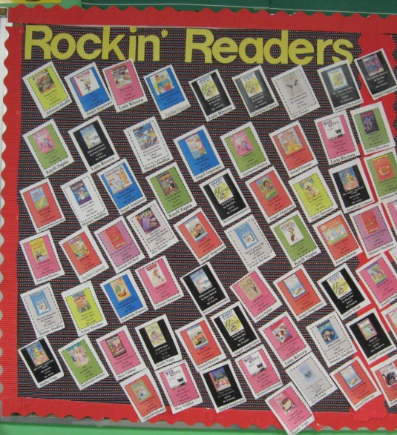
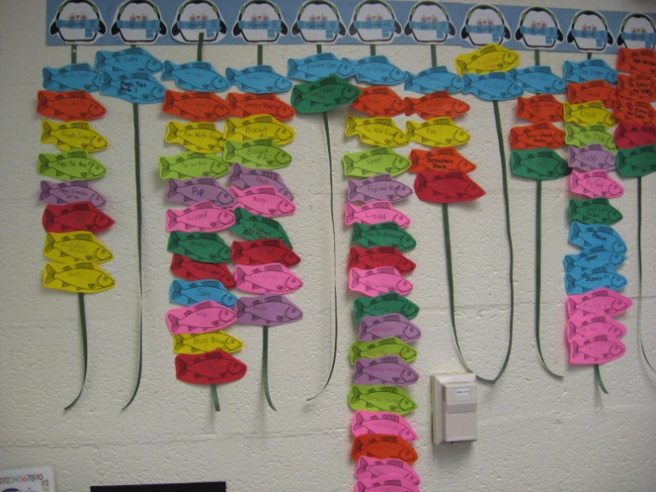
Tracking Student Progress

Slide 23
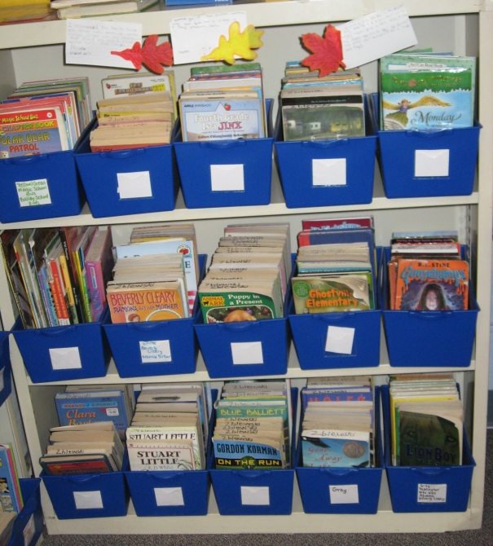
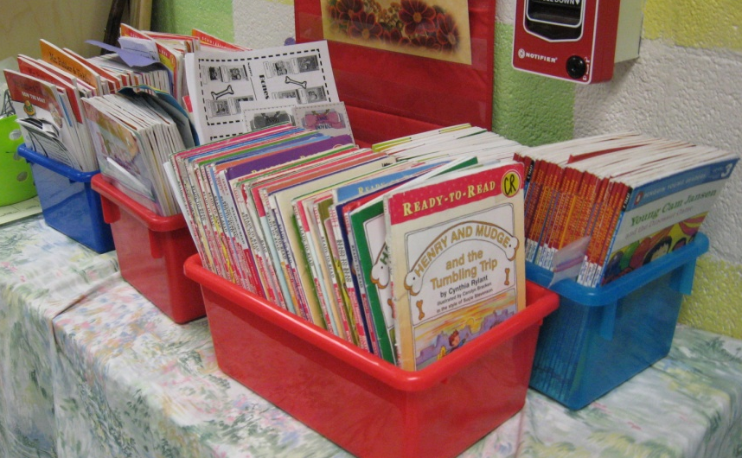
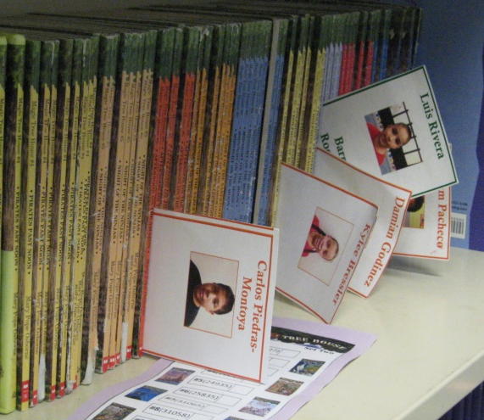
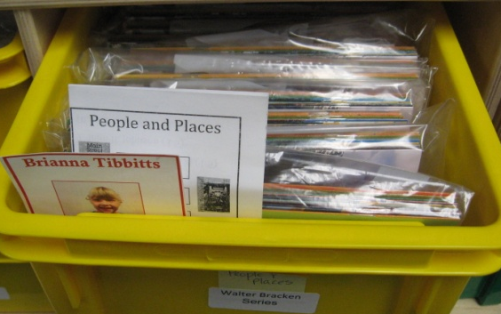
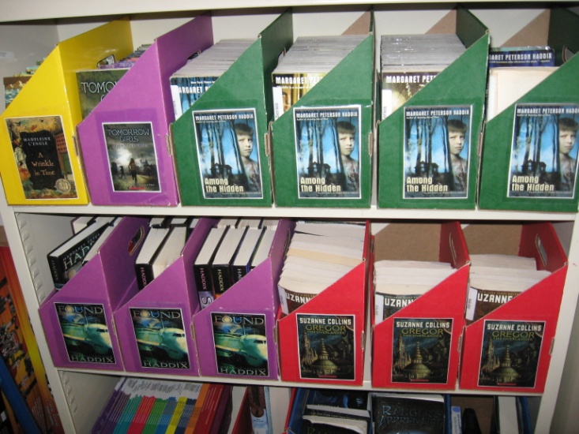
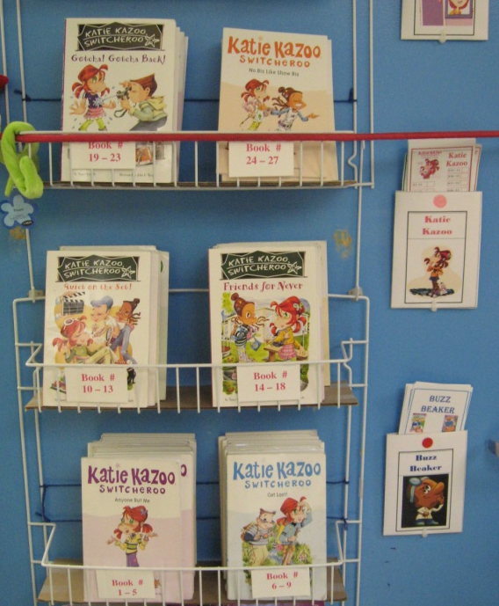
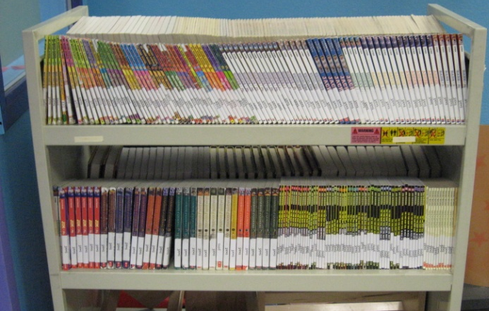
Ways to Organize Books

Slide 24
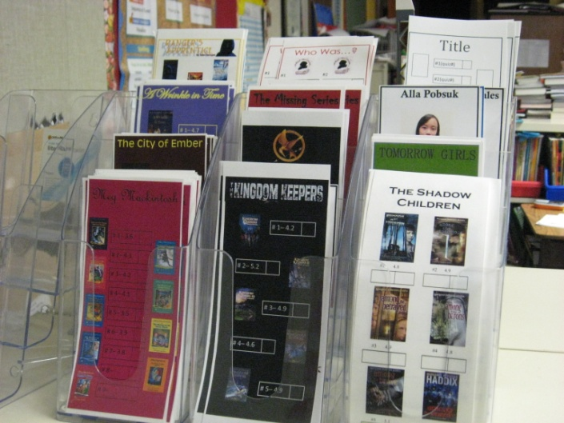
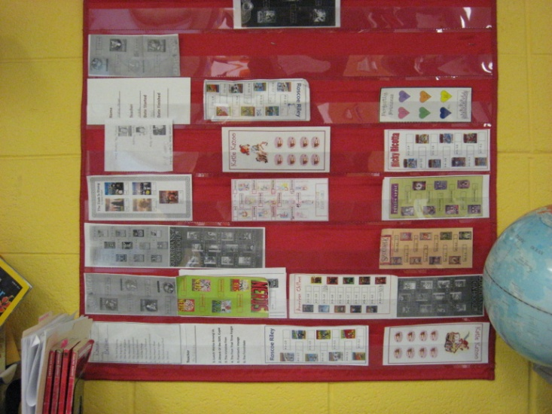
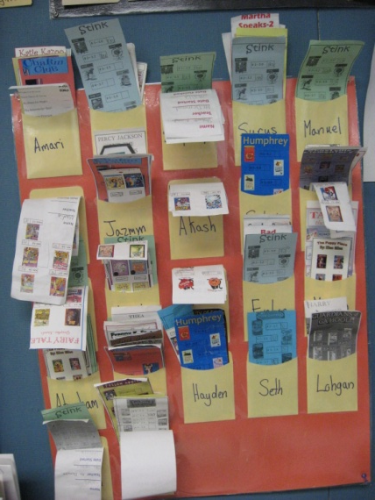
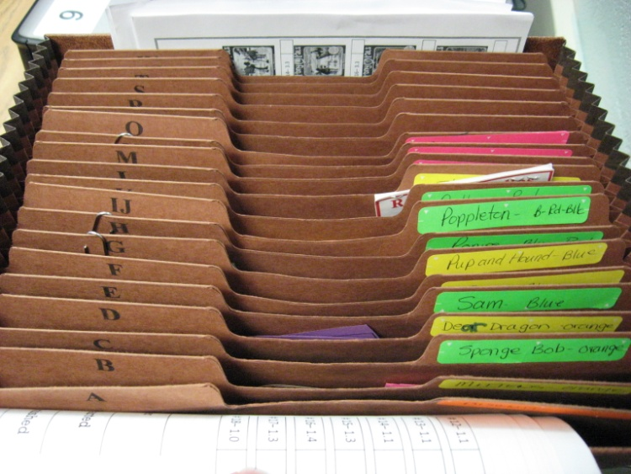
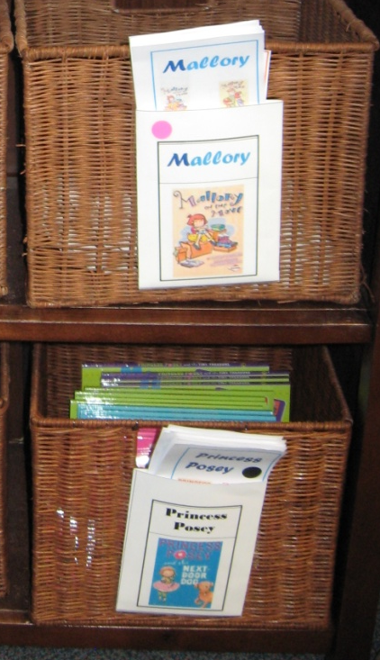

Ways to Organize Bookmarks

Slide 25



Keeping Tracking of Books
Face bookmarks
Sign out sheets/binders
Book Retriever App on Ipad ($.99)

Slide 26






A Culture of Reading

Slide 27

Contact Information
  Walter Bracken STEAM Academy
  1200 N. 27th Street
  Las Vegas, NV. 89101
  702-799-7095
  http://schools.ccsd.net/bracken/
  Katie Decker
  Principal
  Christine Herbert
  Magnet Theme Coordinator

